Slide 1
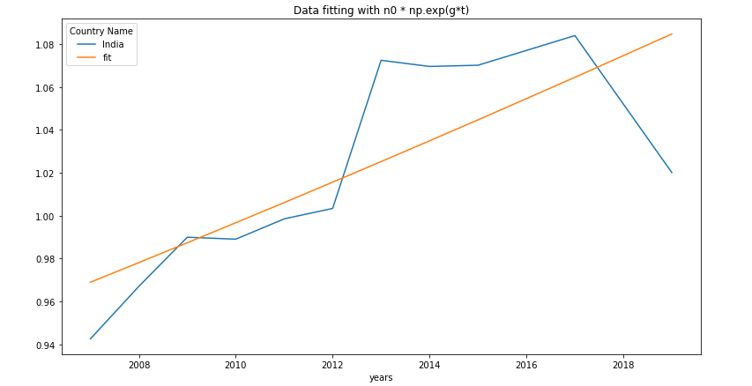
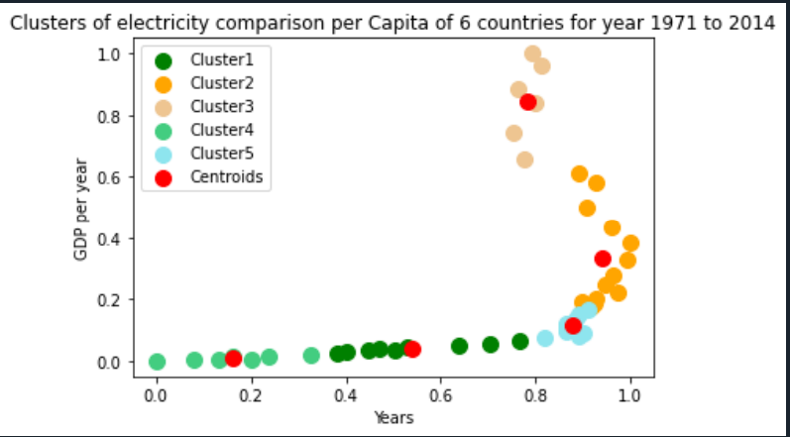
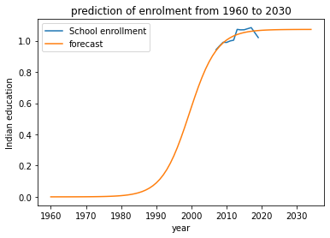
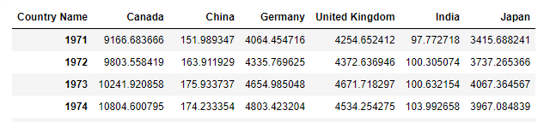
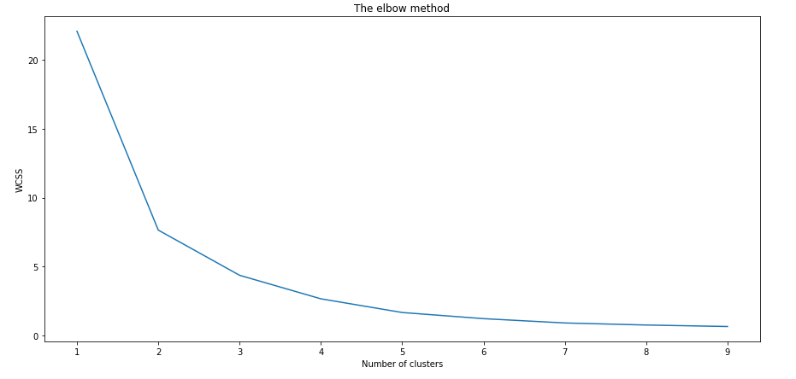
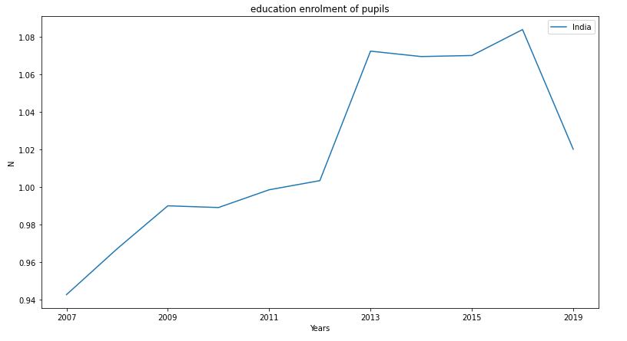
APPLIED DATA SCIENCE ASSIGNMNT - 3
Git Hub Repository link:- https://github.com/puneethegde72/Cluster-and-Fitting.git
Introduction
Clustering, which seeks to group the items based on their similarity, plays a crucial role in data science. The density of the data, graphs, or any other such statistical observations or distributions are used to categorise the data.
Fitting refers to the changes made to the parameters in order to increase the precision of the data or outcomes.
By using above elbow method 3 suitable cluster points which are 2 3 5 as 5 is the last cluster point because of that 5 cluster point has been selected for K-Means algorithm.
The above image shows the education enrolment of India from 2007 to 2019 and as you can observe the people who are getting enrolled is increasing year by year.
To find the fit we have used to fitting method which are exponential function and logistic function
Pandas was used to analyse the data using an algorithm, clustering, and fitting techniques.
The table below provides data on energy usage for all countries between the years of 1971 and 2014 that were chosen for this study with the intention of conducting a comparative comparison. The graphic makes it obvious that as the population has grown, the overall demand of energy has gone up year after year.
In exponential fitting method we have used formula “f = n0 * np.exp(g*t)” and in logistic fitting we have used “f = n0 / (1 + np.exp(-g*(t - t0)))” and results are there as below
Method
China, Japan, Canada, Germany, the United Kingdom, and India were the nations chosen. Several statistics, including per capita energy consumption for K-Means clustering and the number of pupils enrolled in elementary and secondary schools for data fitting and data prediction.
utilised MinMaxScaler() to normalise the data collection before using the necessary function for clustering and fitting.
Six national statistics from 1971 to 2014 were utilised in K-Means and for fitting from 2007 to 2019 has been utilized, and the predictions were made between 1960 and 2030.
With the above visualization we can see that fit has been successful and the predication of the student enrolment has been generated by the logistic fitting as shown below
Results
The above image is showing that how the energy consumption has been increasing every by year and as the people are getting educated the renewable energy usage us getting improved that can be seen in cluster-2 and energy consumption per capita was most in cluster 5.
K-Means:-
In order to conduct a comparative analysis using the clustering and fitting approach, all of the indicators that were chosen for this study for all of the nations are shown in the above image.
The findings are displayed below after first applying the k means procedure to determine how many clusters are required.
According to the projection shown in the above graphic, student enrolment increased significantly after 1990 after showing relatively little change up to that point. Beginning in 2025–2026, enrolment is expected to stabilise.
Fitting:-
The data for Indian education enrolment from the years 2007 to 2019 was used, and I used the pupils enrolled in elementary and high schools for fitting.
Because the educational system and people's way of life are being updated on a daily basis, the number of students enrolled directly depends on energy consumption.
Conclusion
As a nations population increases so will its need for services which will increase the amount of energy consumed. Population education and energy consumption are related to each other. There was a decrease in energy consumption when there was less students. The demand for various applications led to an increase in energy consumption once students were in school.

